Slide 1
Example: Objectives
1
Get acquainted with each other
Become familiar with the syllabus
Mark important dates
Understand the assignments
2
3
Be ready to share one conclusion and the evidence behind it.
Notes:
Editable pattern: Objects
Duplicate this slide to outline objectives. Adjust the number of objectives, timing, grouping instructions, and visible emphasis for the specific activity. Keep the title descriptive and preserve the reading order: title, then steps.

Slide 2
Example: Prompt and Outcome Callout
Prompt
Using the study scenario, identify the exposure, outcome, and comparison you would need to estimate an association.
Expected outcome
Be ready to name:
A plausible exposure
A plausible outcome
The comparison group
One question your group would need to resolve
Notes:
Editable pattern: Prompt plus expected-outcome callout
Duplicate this slide when learners need a focused prompt plus a concise statement of what they should produce. Adapt the prompt, response mode, and sidebar length for the activity. Keep the reading order: title, main prompt, then expected-outcome callout.

Slide 3
Example: Two-Panel Comparison
Concept A
Concept B
Describe the first concept, approach, or option.
Add a short implication, strength, or limitation.
Describe the second concept, approach, or option.
Add a short implication, strength, or limitation.
Notes:
Editable pattern: Two-panel comparison
Duplicate this slide when two concepts, approaches, populations, or options need a side-by-side comparison. Replace both headings and all panel text; use meaningful headings rather than relying on the yellow and green rules to convey the distinction.
Keep the panel backgrounds and top rules decorative. Confirm the reading order is: title, left-panel heading and text, then right-panel heading and text. Use a different structure for dense comparisons or true tabular data.

Slide 4

Example: Image-Supported Profile or Explanation
Use this space for a concise profile, case description, or explanation. Keep the text focused on the information learners need to understand before or while viewing the image.
Notes:
Editable pattern: Image-supported profile or explanation
Duplicate this slide when an image helps introduce a person, setting, case, or concept. Replace the image and accompanying text together; do not use an image merely to fill space.
Crop the image to the right-side frame. Add concise alt text when it conveys information not already available in the text; mark it decorative only when the text fully conveys its purpose. Keep the reading order: title, main text, then image.

Slide 5
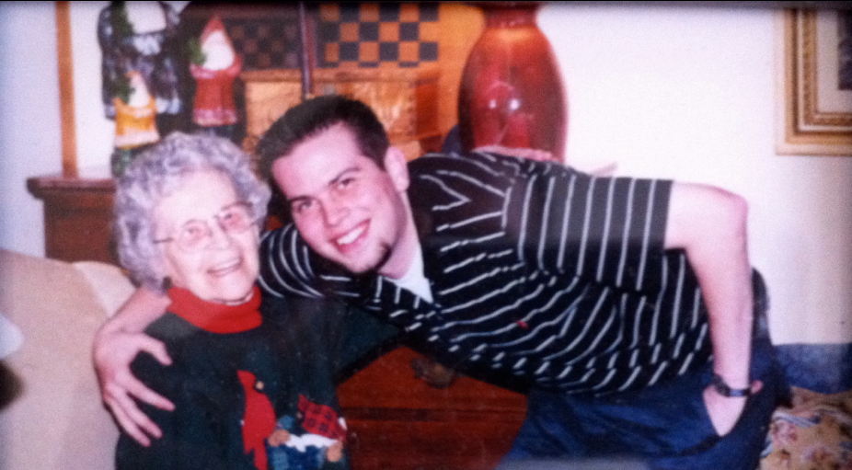
Example: Full Screen Image with Hidden Title
Notes:
Editable pattern: Full-screen Image with Hidden Title
Duplicate this slide to display a full-screen image. A title and alt text are required for screen readers.

